Slide 1


Massachusetts RIMS
March 2012
Supply Chain Risk Management:
Developing the Roadmap
Business Impact Analysis
Alma College, Ontario - 2008

Slide 2
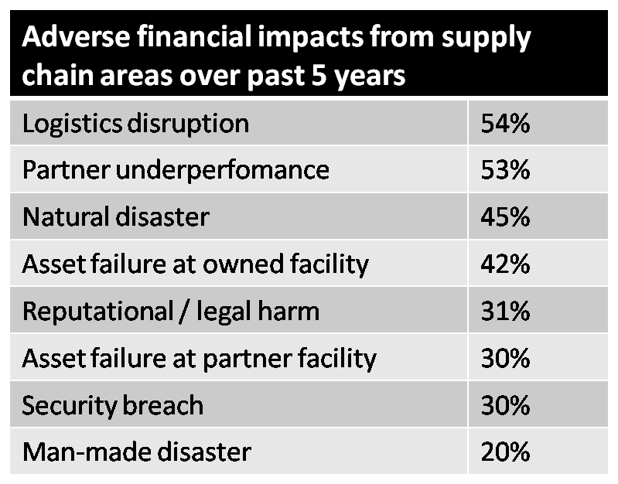
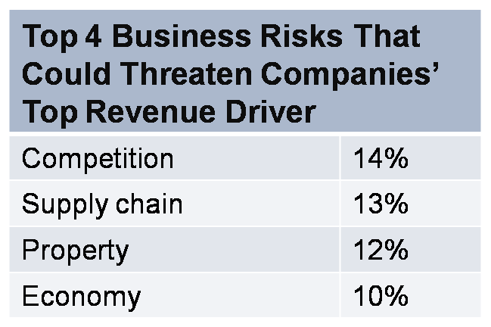
Financial Executive Concerns
Property and supply chain risks represent 2 of the top 3 risks to top revenue drivers, according to financial executives
Roughly 50% of surveyed executives believe their firm was at least somewhat negatively impacted by their supply chain, often due to property-related risks
Notes:
I’m sure most or all of you are aware that supply chain risk has been a major news item over the past year or so…given the tragic events in Japan, etc…….It will probably take months before we begin to understand the full impacts of the supply chain disruptions that have occurred…and as that happens much of what I’m about to discuss will likely change, as concerns over supply chain disruptions caused from property-related events will surely increase.
But it’s not like these concerns have been lost on executives before now…as this survey data indicates which was done a couple of years ago.
First, financial executives in one survey indicated that supply chain and property risks pose 2 of the 3 top risks to their firms top revenue drivers.
In addition, in another survey of financial execs, over 50% indicated their organization had experienced some sort of adverse financial impact from a supply-chain-related disruption over the past 5 years, and property-related causes were often cited as the reasons for the disruption.

Slide 3
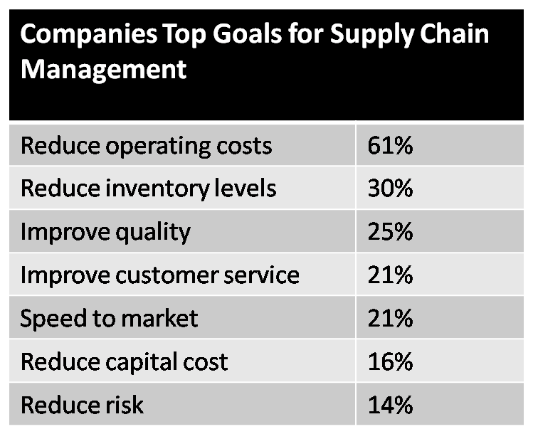
Executive Goals
Executives acknowledge the risks, but don’t make it a high priority to deal with it?
How many incorporate property-related risk evaluation into supply chain risk management efforts?
Notes:
However, in that same survey, when these executives, were asked what their top goals were for supply chain management…and risk reduction was well down the list as you can see.
And even within reducing risk efforts, the inclusion of identifying and managing property-related risks within the supply chain is rare.
All of this illustrates a fundamental problem for all of us here…the top goals for management when it comes to supply chain unfortunately tend to increase risk, making everyone’s job here that much more challenging.

Slide 4

Pressures lead to increasing risks
and accountability to manage risk
Notes:
So this is where many companies are headed more and more often, putting more eggs into fewer baskets…and unfortunately, many of those baskets are in parts of the world where bad things tend to happen more frequently – fires, floods, EQ, storms, political unrest, etc……and then if something bad happens that the organization isn’t well prepared for, somebody is usually held accountable. Risk management is increasingly put on the front lines to be accountable to ensure this happens.

Slide 5

The Ripple Effect:
Shareholder returns were 33-40% lower over a three year period
Share price volatility was 13.5% higher
Operating income declined by 107%
ROA declined by 114%
Sales declined 93%
Sales growth declined by 7%.
800 supply chain disruptions over an 11 year period- Don’t Let Supply Chain Disruptions Torpedo Shareholder Value and Profitability!, Vinod R. Singhal
Notes:
To illustrate this point another way, let’s look at a study that was done a few years ago done by 2 professors, 1 at the Univ. of Western Ontario and the other at the Georgia Institute of Technology, that attempted to gauge the impact of a supply chain disruption on a company’s financial performance. They looked at 800 various supply chain disruptions over an 11 year period, shows that the impacts of a disruption along the chain are not only varied, but have a wide and rippling effect across an operation.
Now, these statistics are aggregated and show the averages, and primarily gauged the financial effects immediately following the disruption. Certainly, a small disruption will not have as large or as long lasting an impact, and we’ve seen in Japan that most companies who had a plan in place were able to recover within a shorter time period, six months or so. But what this does underscore is that the effects of even a relatively minor a supply chain disruption can have a huge impact in terms of both time and money, well beyond simple product delivery delays or a small dip in sales.

Slide 6
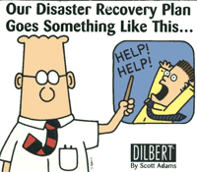
And yet…
Notes:
And yet, when risk managers ask for additional resources to accomplish this more effectively, particularly with creating or upgrading business continuity initiatives, they often don’t get what they ask for.
And unfortunately, when it comes to BCP, there are still a lot of companies that still don’t get it…continuing to think “it won’t happen to us”…with inadequate BCM frameworks and inability to adequately assess supplier BCPs…and some of your suppliers may well be thinking that way also.
Given the business environment and the impacts that can result, can you really afford to think like this, or do business with a company that thinks that way?

Slide 7
The Evolving Landscape
Internal risks
  Traditionally covered
External risks?
  Do risk management efforts match that for internal risks?
    Increasing importance / blurred distinction
    The property risk and resiliency blind spots
Notes:
So, here’s where I’m headed with all of this…traditionally, internal risks have been focused on and, hopefully, are understood adequately…although there’s always room for improvement there…
But the area that holds even more promise for improvement lies in the understanding of external risks…specifically within the supply chain. And as I noted earlier, these risks are generally increasing across the board and the distinction between internal and external risks has become less obvious. Many companies that work hard to manage the risks and prevent losses at their facilities often fail to apply those concepts to those locations owned by their suppliers…and often, these locations are every bit as important to their operations as those locations they own and control.
Furthermore, many companies that do focus on supply chain risks often overlook property risks, creating a “blind spot” in their efforts…and as we noted earlier, a majority of CFOs recognize that property risks can create a significant threat to their business and they protect their owned locations in a manner consistent with that.

Slide 8

Tackling the issue:
The need for information…
Understanding risks in quantifiable terms provides the roadmap
Notes:
So how do you tackle these issues? Well, you need information to determine what direction you should go in.
Imagine driving in a new place…say in Europe where road sign may look something like this…when the signs are clearly marked and you have a good map, it’s not too difficult to get to where you want to go.
Now consider what happens without the map and where the signs aren’t marked and there’s no map…they just look like this. How would you feel? Concerned? Maybe even a little panic? It’s going to be tough to know what direction to take.
Now think about a management team for company…they are accountable for effectively managing the risks that face their company…constantly balancing risk and reward with the decisions they make daily. And the Risk Manager is often the lead person to ensure this happens properly…often having to do so with minimal resources, always being asked to squeeze more out of less. And the entire team doesn’t necessarily have a good handle on the risks that face their business and way to effectively prioritize those risks.
In other words, they’re trying to manage their risks without road signs or a map…so it’s very difficult for them to be sure they are doing an effective job and getting the most out of those limited resources. It’s important to understand risks in quantifiable terms, and by doing so, provide the information that’s needed to help ensure risks are managed as effectively and efficiently as possible.

Slide 9
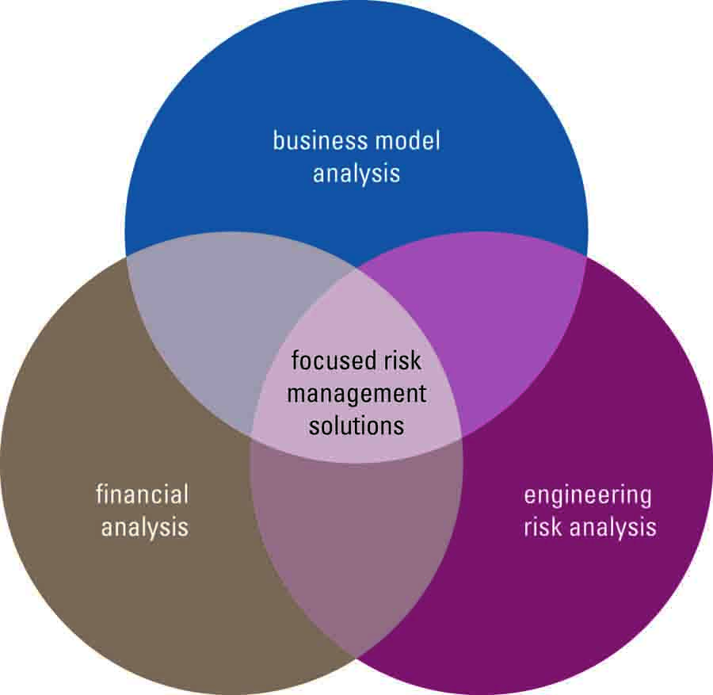
Business / Supplier Impact Analysis
Measures the enterprise-wide impacts to an organization in the event of a major disruption to key business processes
  Financial $ quantification of specific exposures
  Applied to internal as well as external processes / facilities
Notes:
I’ve seen the term BIA defined in a number of different ways, with differing approaches…for us, we define our approach as …….leveraging our engineering knowledge to create what we think is a more holistic view of the risks, and possible mitigation solutions, that a client can use to help direct their risk management efforts. It’s a process that can be used to quantify both internal as well as external risks, as the process can be extended into the supply chain and applied to specific supplier locations.

Slide 10

Information sharing is critical
Operations
Finance
Purchasing
Risk Management
to create a prioritization map
Notes:
One of the key points of a BIA is the fact that it pulls information from all areas of the company, which you need to fully understand the risks. Within every company there exists informational silos…each area knows their part of the puzzle…and the real trick to effectively understanding the key risks to the business is to be able to cut across these silos…to take bits of information from each and integrate it together and then to get the silos talking to each other and sharing information…that’s the only way to get all of the information you need. So don’t fall into the trap of thinking all the info you need resides with one person or in one area. Cooperation between functional areas is absolutely critical to the process. The goal is to create a prioritized order for these risks to allow you to focus your efforts where it counts the most.

Slide 11
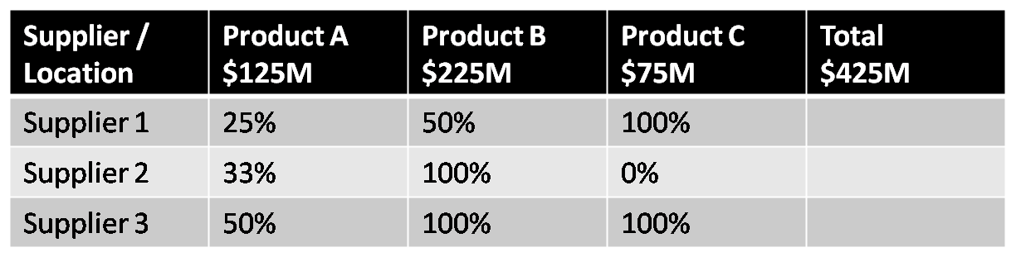
Quantification approach
Dependency mapping – identify ultimate revenue / variable margin streams directly & indirectly impacted
Interdependencies include
  Operational (plant to plant)
  Product or associative (hardware / service)
  Supportive (data center, logistics, etc.)
Notes:
One of the first things you have do as part of the quantification process is understand what revenue / margin streams are impacted, both directly and indirectly. Interdependencies have to be considered here. Again, you may need to talk to multiple operational areas to ensure you have a full understanding of all of the potential impacts.

Slide 12
Quantification approach
Assumption needed for recovery / replacement time – worst case scenario
Assess mitigation capabilities – 2 stage process
  Internal: Inventory, supplier alternatives, etc…net against incremental expenses anticipated
  External: In-depth supplier analysis to evaluate resilience
Consider market share impacts (post-recovery)
  Estimate initial loss of customer base & recovery curve
Notes:
Before this first step here, you have to decide which part of the business you want to focus on first…it’s usually too daunting of a task to try and address the entire company at once.
Secondly, you also should try to group your suppliers into categories, focusing first on those suppliers that are considered sole-sources, where no alternative is currently identified. Other types of suppliers may represent critical exposures as well, but the most significant are likely to come from those sole-source providers.
Then you go through the dependency mapping process that was just discussed.
Think of the entire process as a funnel…you typically have to start with a large number and you’ve got to whittle it down to something that is manageable to work through.
Also, note that this approach is revenue/profit-based…not cost-based. The amount of spend on suppliers is not a reliable factor of how much risk is associated with any specific supplier.

Slide 13
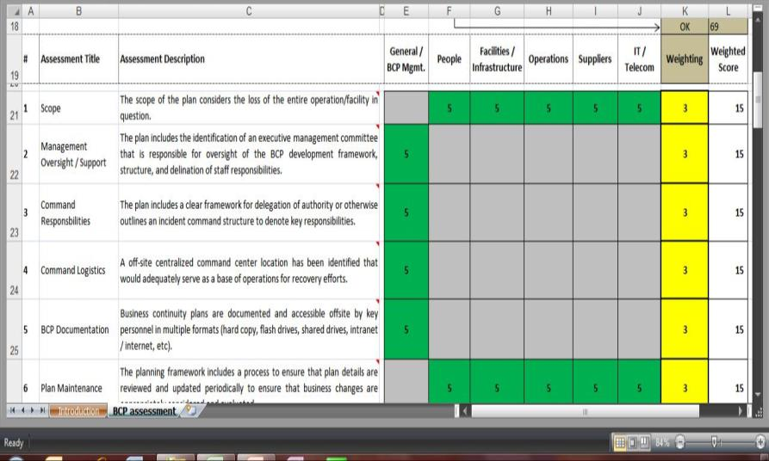
BCP Assessment
Notes:
Many companies require their suppliers to have a BCP, but they don’t always have effective methods to evaluate those plans to determine if they can even remotely be relied upon. To facilitate this process, we developed a BCP assessment tool recently that allows a user to assess, or numerically rate, a BCP across roughly 20 different assessment areas, and how each of those areas are effectively addressed across 5 key business dimensions – BCP management, people, infrastructure, operations, suppliers, and IT. It also allows for a weighting to be utilized if the user believes some assessment areas carry more weight that others in a specific situation. This allows for a user to consistently and objectively assess a BCP for a company or a group of companies on a comparative basis.

Slide 14
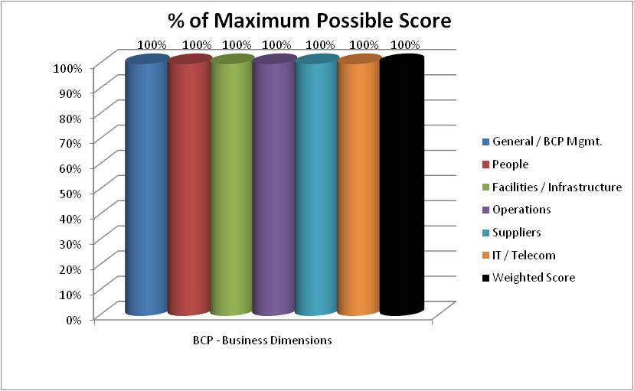
Output
Notes:
The output can look something like this…the user can determine what % should reflect an acceptable grade given their specific conditions and parameters they need for their situation.

Slide 15
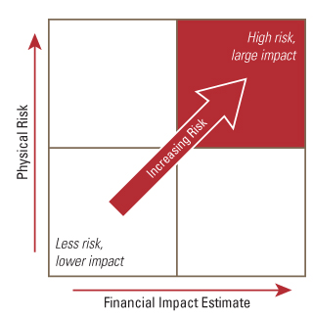
Risk evaluation – physical & financial
Consider the relationship between physical risk and impact to the business when evaluating risk mitigation strategies
Notes:
Once you’ve determined the potential financial impact to the business that a loss could bring, you can the add a measure of the physical risk that is thought to exist. This allows you to then plot the relationship between the 2 aspects for multiple suppliers, allowing you to prioritize which ones should be focused upon from a risk improvement standpoint and which should be focused on from a business resilience standpoint…and which ones where both are needed. The idea is to drive these locations towards the bottom left corner, where physical and financial risk are both minimized.

Slide 16
Evaluation summary
Business segment selection
Identify key suppliers and categorize
  Sole sources are highest priority
Quantification process
  Internal – via BIA analysis
  External – SIA analysis / BC evaluation
Physical risk evaluation
Apply to other supply chain threats
  Logistical concerns
  Ports, transportation routes, etc.
Consider mitigation / transfer issues and solutions
Notes:
So, just to backup and recap for a moment, here’s how the process flows…we really started with #3 here, and didn’t mention #1 and 2…depending on the type and size of your organization, you may be able to do the entire company or just start with a small portion of it, but it has to be a manageable size.
Also, note #5 here…you have to consider not only supplier facilities, but also consider other points along the supply chain and their impact if there is a major disruption at those points.

Slide 17
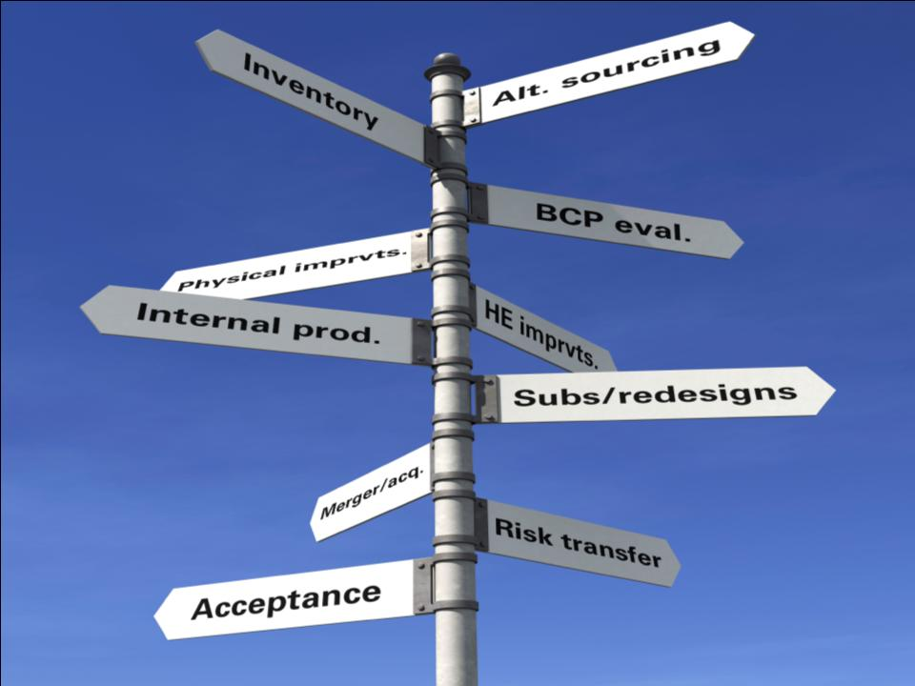
Directional Options
Cost / benefit comparisons
Notes:
So, back to the road signs, only this time, you’ve got information to work with…after going through this process, you’ll be able to better determine which direction you need to go, and you can be much more confident you are managing company supply chain risks in the most cost-efficient manner possible.
Discuss potential strategies that can be employed…provide examples where possible.

Slide 18

Summary
BCM more critical; internal and external application
BIA provides prioritization to make manageable
  Quantifications with assessment of physical risks
  Optimizes mitigation strategy selection
  Framework includes loss prevention
Does the management of internal and external risks match?
Notes:
So, to wrap things up…you need a map to know where to go!
A number of forces are driving businesses towards BCM and ERM frameworks, and within these frameworks it is becoming increasingly more critical to understand the threats posed to the business…and in particular, supply chain risks are becoming more critical to gain better awareness of…and to manage these risks more effectively…a $ quantification and prioritization process is the best way for many companies to approach this issue, allowing you to focus on those most critical and determine if these risks are adequately being dealt with.
And consider whether or not your view and management of internal and external risks match.

Slide 19

Michelle Braun
FM Global
Business Risk Consulting

